Slide 1
Convolutional Neural Networks
Computer vision

Slide 2
Objectives
To discuss Convolution Neural Networks (CNNs)
To understand the convolution operation
To understand the pooling operation
To understand the vocabulary used in convolutional neural networks (padding, stride, filter, etc.)
Building a convolutional neural network for multi-class classification in images

Slide 3

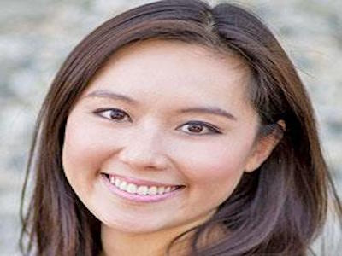
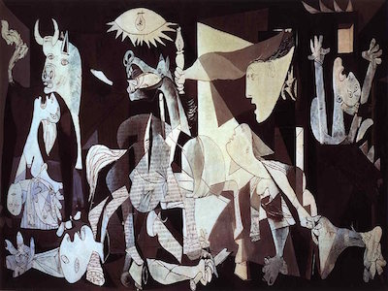
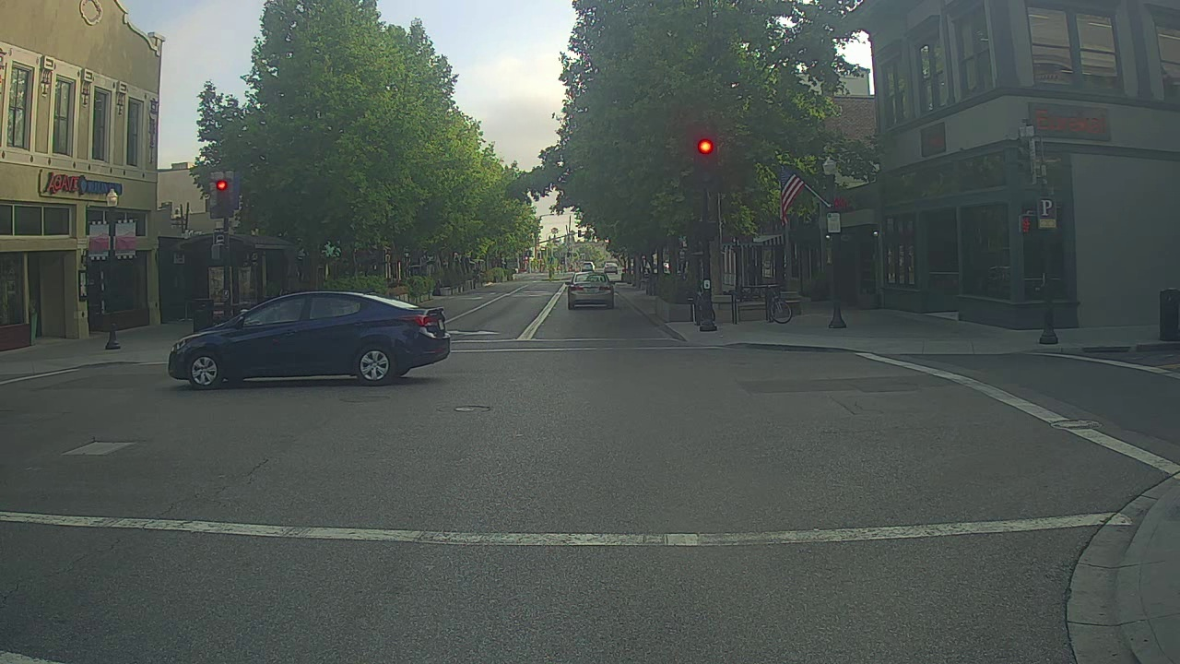
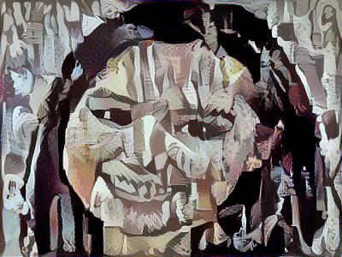
Computer Vision Problems
Image Classification
Neural Style Transfer
Cat? (0/1)
64x64
Object detection

Slide 4
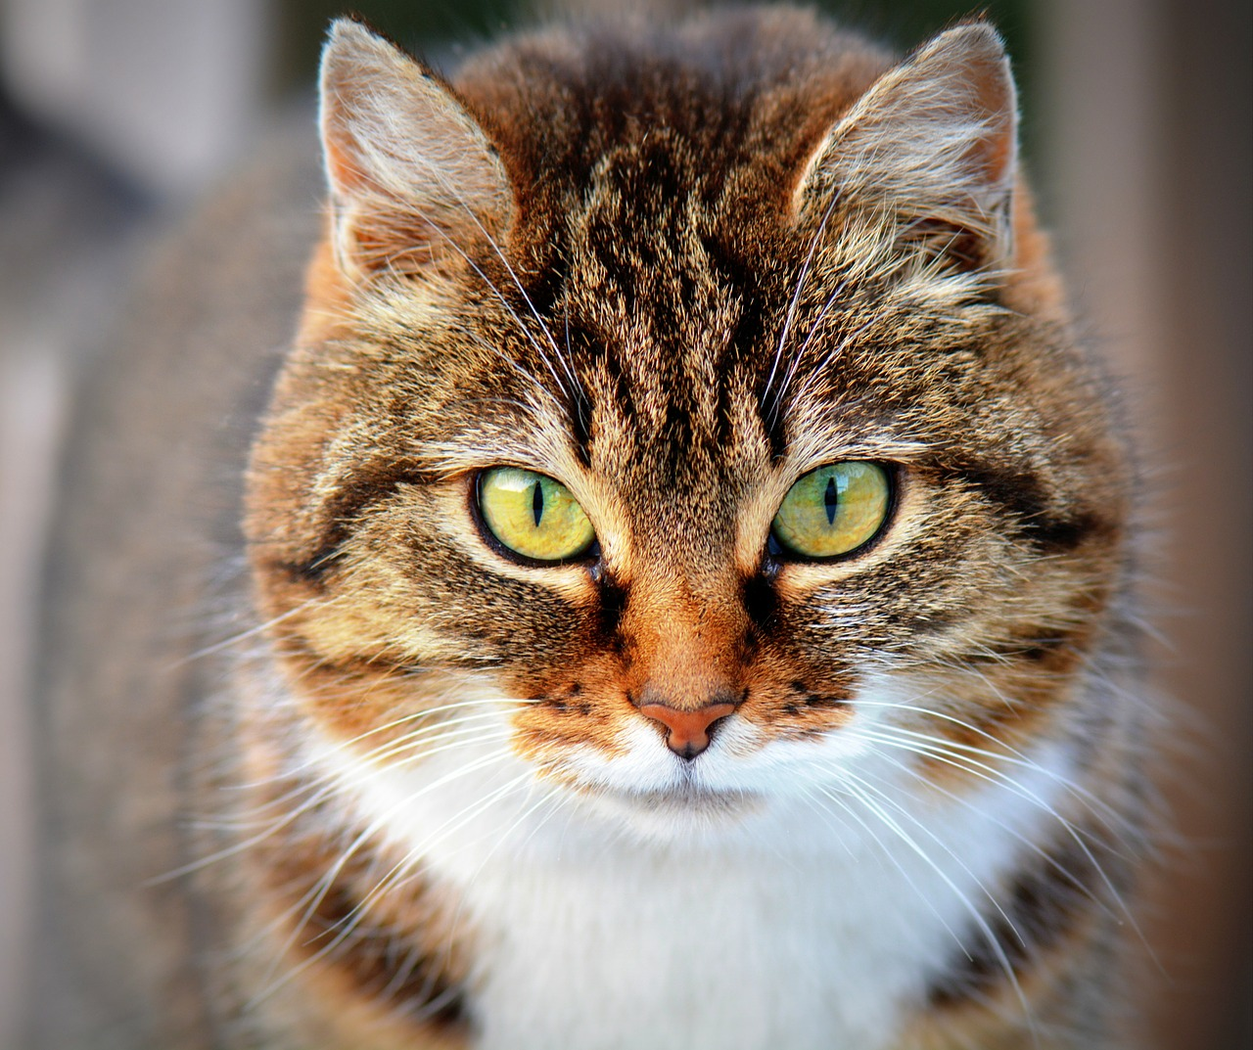






Deep Learning on large images
One major problem with computer vision problems is that the input data can get really big.
A big input to a neural network, the number of parameters will swell up to a HUGE number
This will result in more computational and memory requirements
Cat? (0/1)
64x64

Slide 5
Deep Learning Architectures
Supervised models
Convolutional Neural Networks (CNNs)
Recurrent Neural Networks (RNNs)
Unsupervised models
Generative Adversarial Networks (GANs)
Deep Belief Networks (DBNs)
Deep Boltzmann Machines (DBMs)
Restricted Boltzmann Machines (RBMs)
Auto-encoders

Slide 6
Deep Convolutional Neural Networks (CNN)
Train Network with many layers
Multiple layers work to build an improved feature space
First layer learns 1st order features (e.g. edges)
2nd layer learns higher order features and so on..
Lastly, final layer features are fed into supervised layer(s).

Slide 7
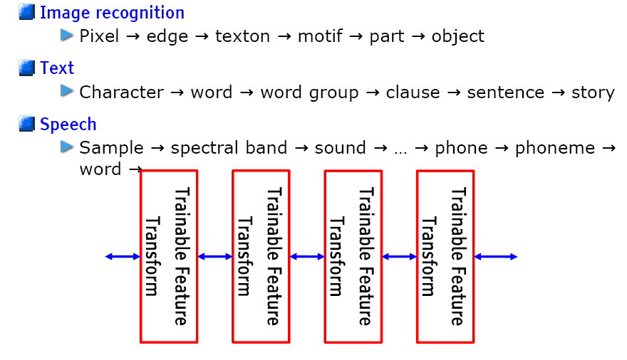
Trainable Feature Hierarchy
Hierarchy of representations with increasing level of abstraction
Each stage is a kind of trainable feature transform

Slide 8
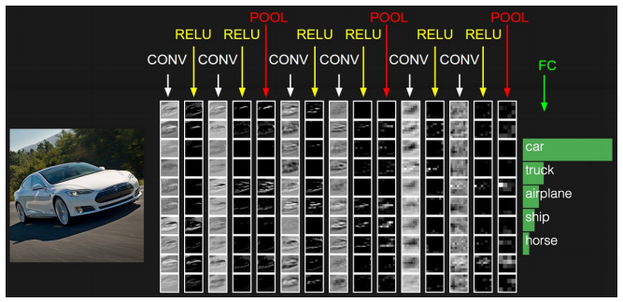
CNN Layers
There are three types of layers in CNNs:
Convolution
Pooling
Fully Connected

Slide 9
Convolutional Neural Networks
Edge detection example

Slide 10
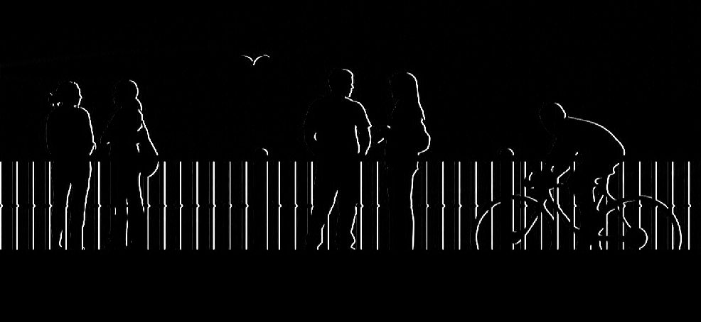

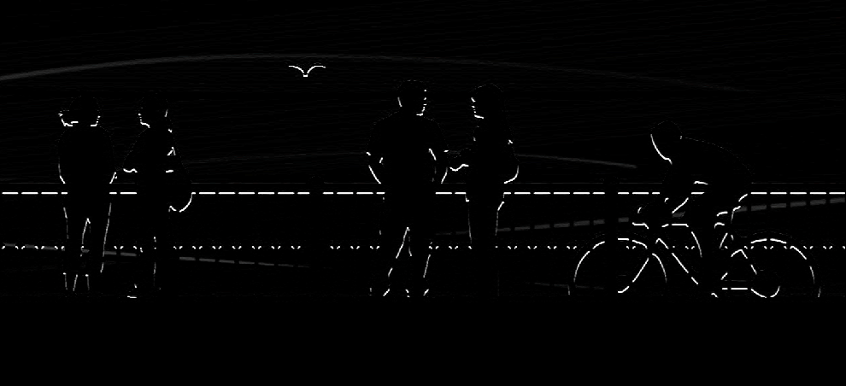
Edge Detection
we will focus on how the edges can be detected from an image. Suppose we are given the below image:
As you can see, there are many vertical and horizontal edges in the image. The first thing to do is to detect these edges:
vertical edges
horizontal edges

Slide 11
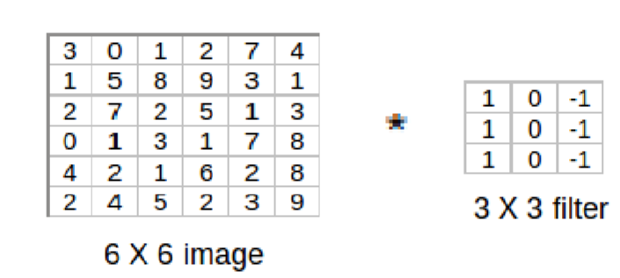
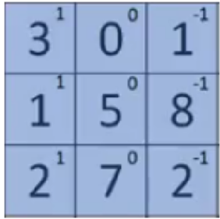
Vertical Edge Detection
But how do we detect these edges? To illustrate this, let’s take a 6 X 6 grayscale image (i.e. only one channel):
Next, we convolve this 6 X 6 matrix with a 3 X 3 filter:
After the convolution, we will get a 4 X 4 image. The first element of the 4 X 4 matrix will be calculated as:

Slide 12
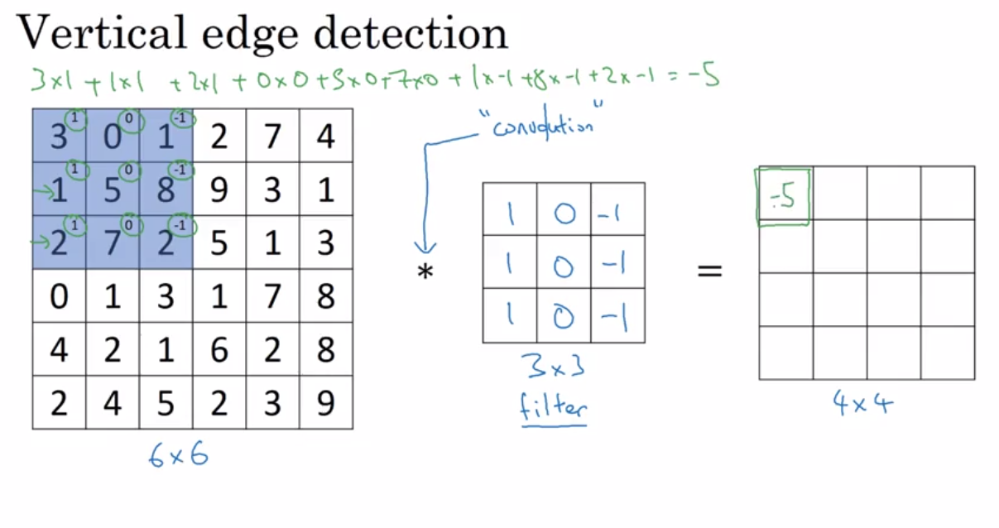

Slide 13
Vertical edge detection
1
1
-1
0
1
1
0
-1
-1
-1
0
0
3 | 0 | 1 | 2 | 7 | 4
1 | 5 | 8 | 9 | 3 | 1
2 | 7 | 2 | 5 | 1 | 3
0 | 1 | 3 | 1 | 7 | 8
4 | 2 | 1 | 6 | 2 | 8
2 | 4 | 5 | 2 | 3 | 9
1
1
1
1
1
0
-1
0
-1
1
0
-1
1
1
0
-1
0
-1
-1
-1
-1
0
0
0
1
1
1
1
0
-1
0
0
-1
1
0
0
-1
-1
1
-1
1
0
-1
1
0
-1
0
-1
1
0
-1
1
0
-1
1
1
0
-1
0
-1
0 | -2 | -4 | -7
-3 | -2 | -3 | -16

Slide 14
Vertical edge detection
10 | 10 | 10 | 0 | 0 | 0
10 | 10 | 10 | 0 | 0 | 0
10 | 10 | 10 | 0 | 0 | 0
10 | 10 | 10 | 0 | 0 | 0
10 | 10 | 10 | 0 | 0 | 0
10 | 10 | 10 | 0 | 0 | 0
0 | 30 | 30 | 0
0 | 30 | 30 | 0
0 | 30 | 30 | 0
0 | 30 | 30 | 0
1 | 0 | -1
1 | 0 | -1
1 | 0 | -1

Slide 15
Convolutional Neural Networks
More edge detection

Slide 16
Vertical edge detection examples
10 | 10 | 10 | 0 | 0 | 0
10 | 10 | 10 | 0 | 0 | 0
10 | 10 | 10 | 0 | 0 | 0
10 | 10 | 10 | 0 | 0 | 0
10 | 10 | 10 | 0 | 0 | 0
10 | 10 | 10 | 0 | 0 | 0
0 | 30 | 30 | 0
0 | 30 | 30 | 0
0 | 30 | 30 | 0
0 | 30 | 30 | 0
1 | 0 | -1
1 | 0 | -1
1 | 0 | -1
0 | 0 | 0 | 10 | 10 | 10
0 | 0 | 0 | 10 | 10 | 10
0 | 0 | 0 | 10 | 10 | 10
0 | 0 | 0 | 10 | 10 | 10
0 | 0 | 0 | 10 | 10 | 10
0 | 0 | 0 | 10 | 10 | 10
0 | -30 | -30 | 0
0 | -30 | -30 | 0
0 | -30 | -30 | 0
0 | -30 | -30 | 0
1 | 0 | -1
1 | 0 | -1
1 | 0 | -1

Slide 17
Vertical and Horizontal Edge Detection
1 | 0 | -1
1 | 0 | -1
1 | 0 | -1
1 | 1 | 1
0 | 0 | 0
-1 | -1 | -1
Vertical
Horizontal
10 | 10 | 10 | 0 | 0 | 0
10 | 10 | 10 | 0 | 0 | 0
10 | 10 | 10 | 0 | 0 | 0
0 | 0 | 0 | 10 | 10 | 10
0 | 0 | 0 | 10 | 10 | 10
0 | 0 | 0 | 10 | 10 | 10
0 | 0 | 0 | 0
30 | 10 | -10 | -30
30 | 10 | -10 | -30
0 | 0 | 0 | 0
1 | 1 | 1
0 | 0 | 0
-1 | -1 | -1

Slide 18
Learning to detect edges
1 | 0 | -1
1 | 0 | -1
1 | 0 | -1
3 | 0 | 1 | 2 | 7 | 4
1 | 5 | 8 | 9 | 3 | 1
2 | 7 | 2 | 5 | 1 | 3
0 | 1 | 3 | 1 | 7 | 8
4 | 2 | 1 | 6 | 2 | 8
2 | 4 | 5 | 2 | 3 | 9

Slide 19
Convolutional Neural Networks
Padding

Slide 20
Padding
We have seen that convolving an input of 6 X 6 dimension with a 3 X 3 filter results in 4 X 4 output.
We can generalize it and say that if the input is n X n and the filter size is f X f, then the output size will be (n-f+1) X (n-f+1):
Input: n X n
Filter size: f X f
Output: (n-f+1) X (n-f+1)
There are primarily two disadvantages here:
Every time we apply a convolutional operation, the size of the image shrinks
Pixels present in the corner of the image are used only a few number of times during convolution as compared to the central pixels.
Hence, we do not focus too much on the corners since that can lead to information loss

Slide 21
Padding
To overcome these issues, we can pad the image with an additional border, i.e., we add one pixel all around the edges.
This means that the input will be an 8 X 8 matrix (instead of a 6 X 6 matrix).
Input: n X n
Padding: p
Filter size: f X f
Output: (n+2p-f+1) X (n+2p-f+1)
There are two common choices for padding:
Valid: It means no padding. If we are using valid padding, the output will be (n-f+1) X (n-f+1) 2.
Same: Here, we apply padding so that the output size is the same as the input size, i.e.,
n+2p-f+1 = n
So, p = (f-1)/2

Slide 22
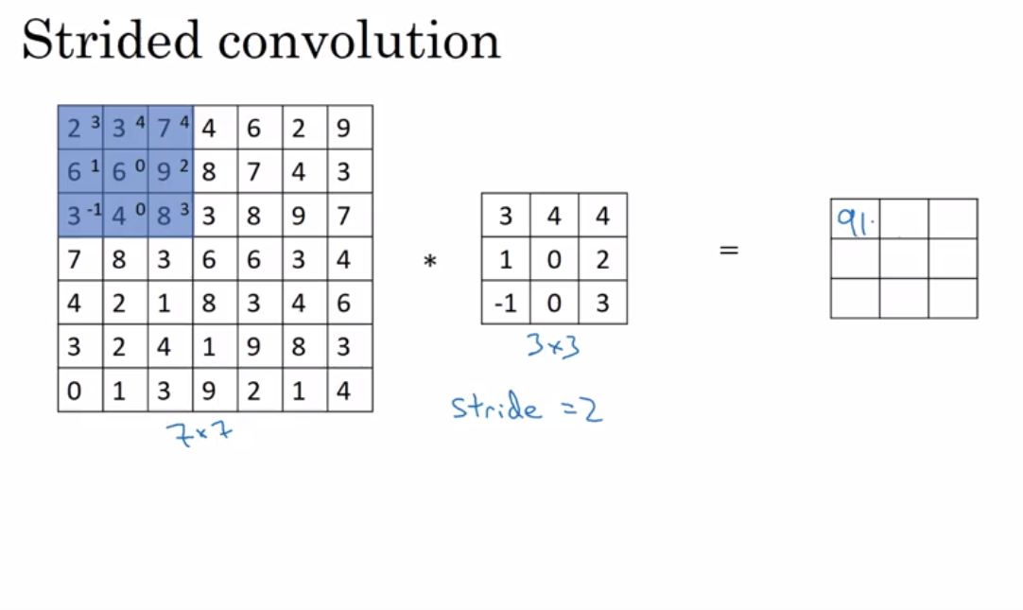
Suppose we choose a stride of 2. So, while convoluting through the image, we will take two steps – both in the horizontal and vertical directions
Stride helps to reduce the size of the image, a particularly useful feature.

Slide 23
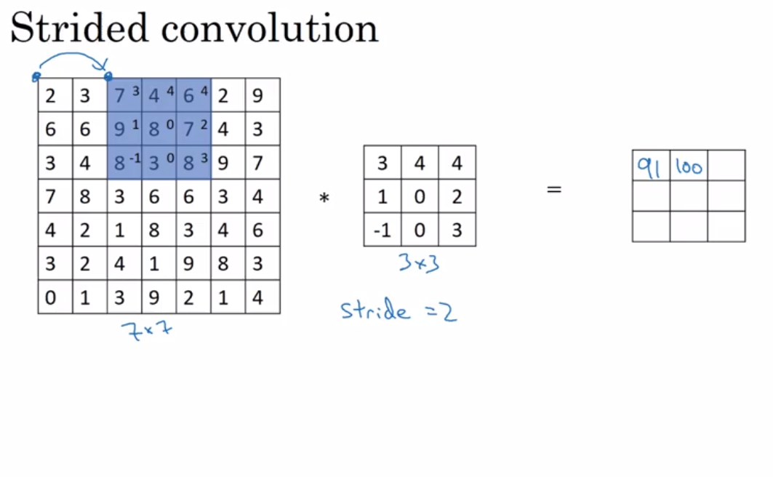

Slide 24
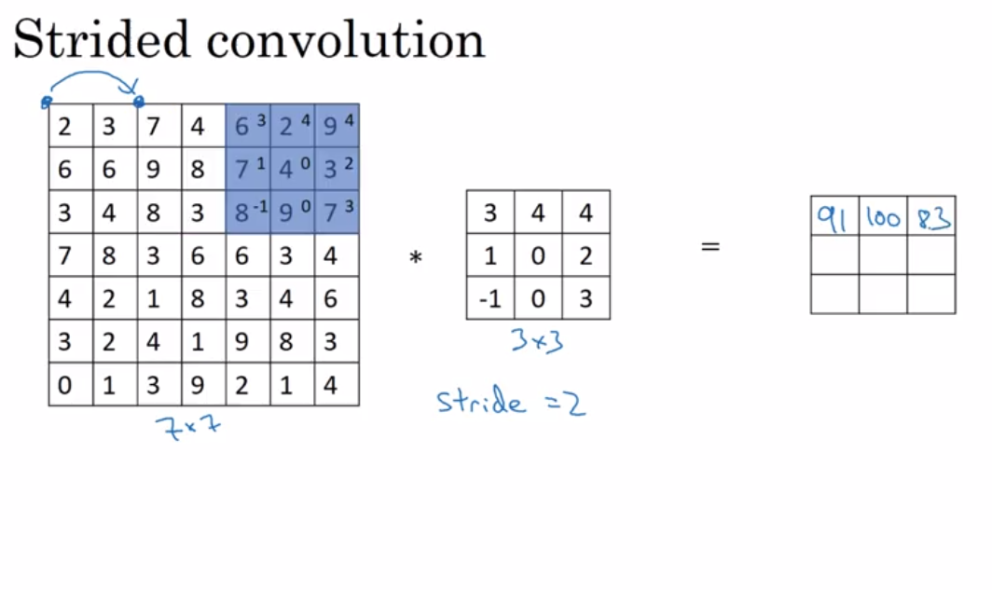

Slide 25
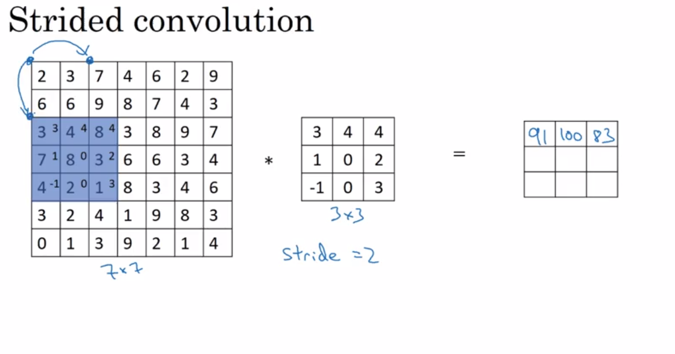

Slide 26
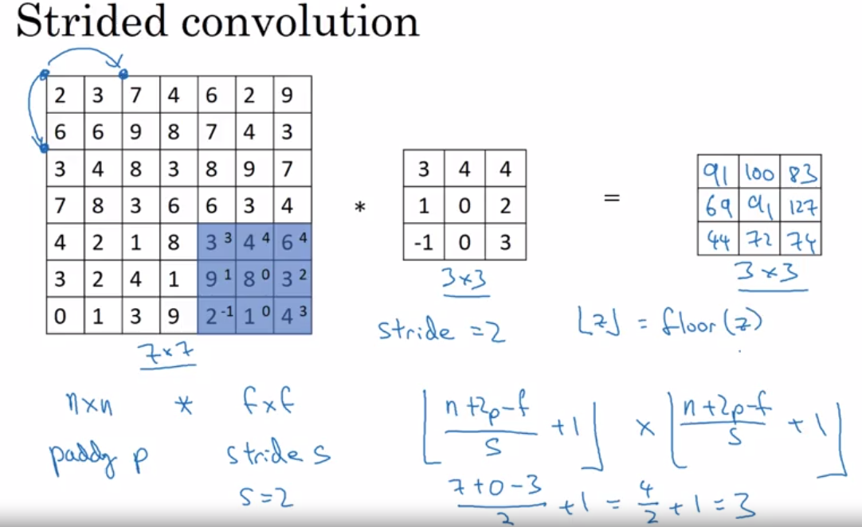

Slide 27
Convolutional Neural Networks
Convolutions over volumes

Slide 28
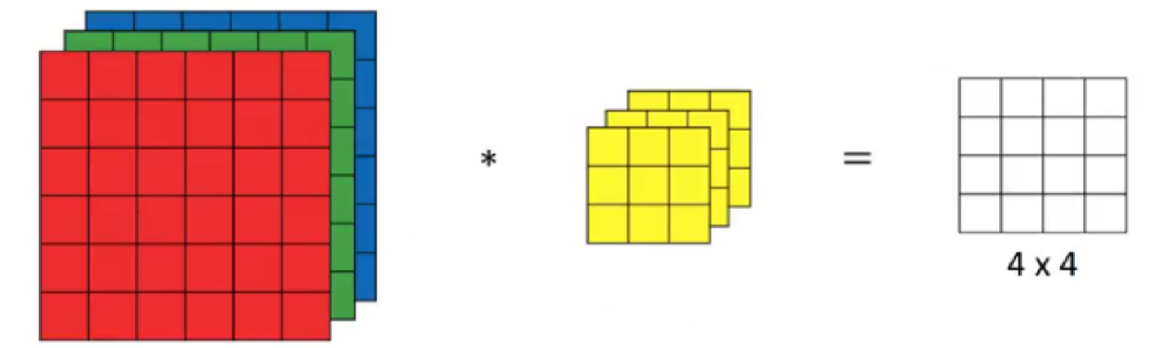
Convolutions on RGB images
Suppose, instead of a 2-D image, we have a 3-D input image of shape 6 X 6 X 3. How will we apply convolution on this image? We will use a 3 X 3 X 3 filter instead of a 3 X 3 filter. Let’s look at an example:
The dimensions above represent the height, width and channels in the input and filter. Keep in mind that the number of channels in the input and filter should be same. This will result in an output of 4 X 4. Let’s understand it visually:
Input: 6 X 6 X 3
Filter: 3 X 3 X 3
After convolution, the output shape is a 4 X 4 matrix. So, the first element of the output is the sum of the elementwise product of the first 27 values from the input (9 values from each channel).

Slide 29
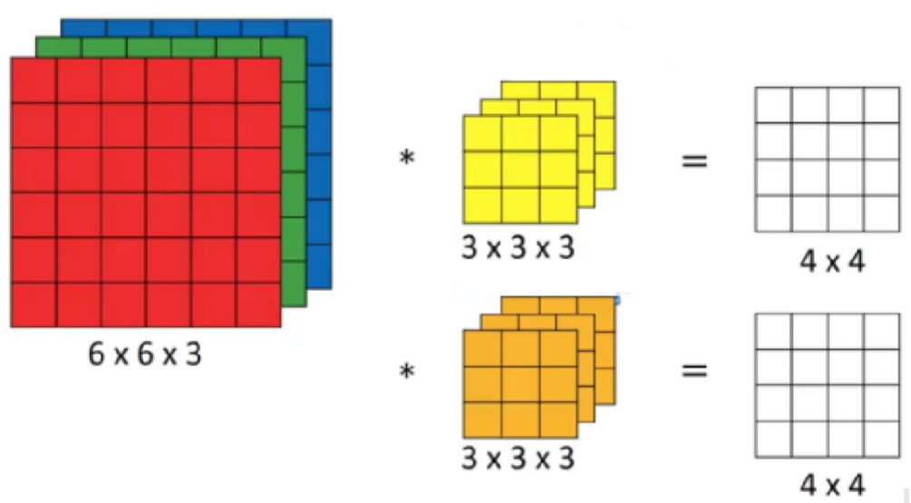
Convolutions on RGB images
Instead of using just a single filter, we can use multiple filters as well.
Let’s say the first filter will detect vertical edges and the second filter will detect horizontal edges from the image. If we use multiple filters, the output dimension will change.
So, instead of having a 4 X 4 output as in the above example, we would have a 4 X 4 X 2 output (if we have used 2 filters):
Input: n X n X n
Filter: f X f X n
Padding: p
Stride: s
Output: [(n+2p-f)/s+1] X [(n+2p-f)/s+1] X n ’
Here, nc is the number of channels in the input and filter, while in output, nc represents number of filters.

Slide 30
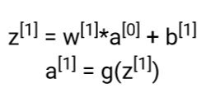
One Layer of a Convolutional Network
Once we get an output after convolving over the entire image using a filter, we add a bias term to those outputs and finally apply an activation function to generate activations.
In our case, input (6 X 6 X 3) is a[0] and filters (3 X 3 X 3) are the weights w[1] . These activations from layer 1 act as the input for layer 2, and so on.
Clearly, the number of parameters in case of convolutional neural networks is independent of the size of the image. It essentially depends on the filter size.
Suppose we have 10 filters, each of shape 3 X 3 X 3. What will be the number of parameters in that layer?
Number of parameters for each filter = 3*3*3 = 27
There will be a bias term for each filter, so total parameters per filter = 28
As there are 10 filters, the total parameters for that layer = 28*10 = 280

Slide 31
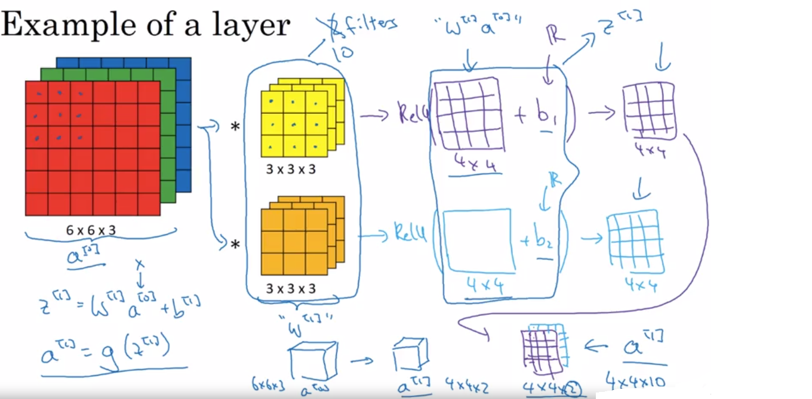

Slide 32
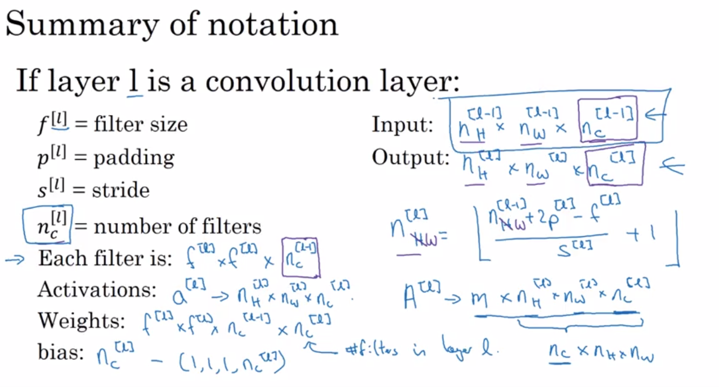

Slide 33
Convolutional Neural Networks
A simple convolution network example

Slide 34
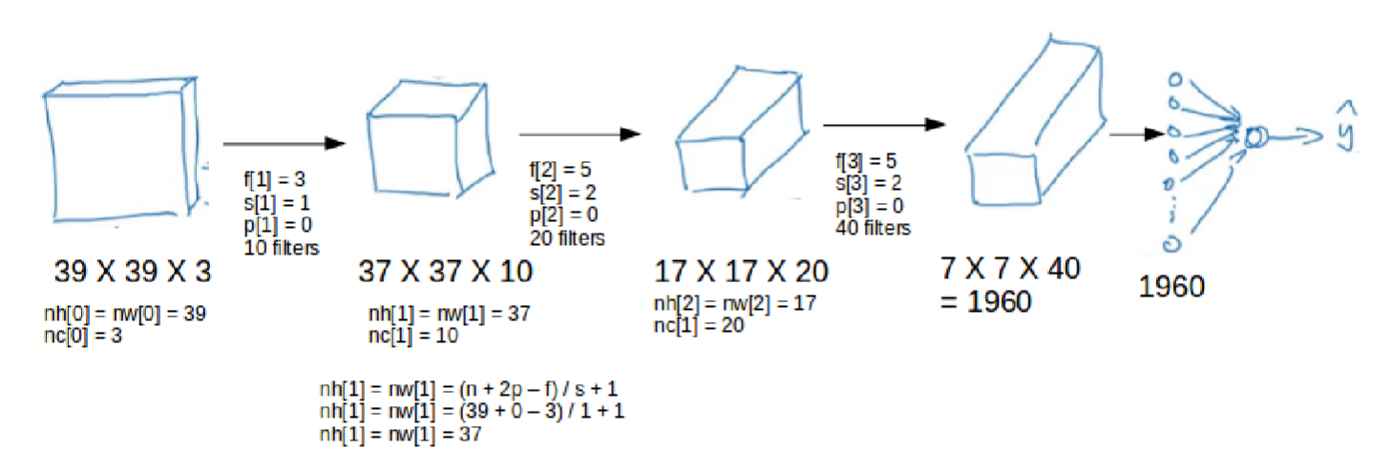
Simple Convolutional Network Example
We take an input image (size = 39 X 39 X 3 in our case).
convolve it with 10 filters of size 3 X 3, and take the stride as 1 and no padding. This will give us an output of 37 X 37 X 10.
We convolve this output further and get an output of 7 X 7 X 40 as shown above.
Finally, we take all these numbers (7 X 7 X 40 = 1960), unroll them into a large vector, and pass them to a classier that will make predictions.

Slide 35
Types of layer in a convolutional network:
- Convolution
- Pooling
- Fully connected

Slide 36
Convolutional Neural Networks
Pooling layers

Slide 37
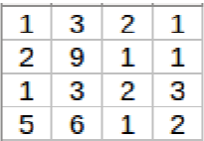
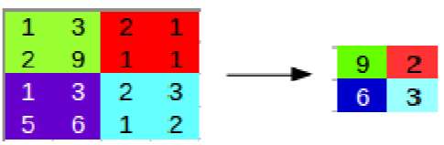
Pooling Layers
Pooling layers are generally used to reduce the size of the inputs and hence speed up the computation. Consider a 4 X 4 matrix as shown below:
Applying max pooling on this matrix will result in a 2 X 2 output:
For every consecutive 2 X 2 block, we take the max number. Here, we have applied a filter of size 2 and a stride of 2.

Slide 38
Pooling layer: Max pooling
1 | 3 | 2 | 1 | 3
2 | 9 | 1 | 1 | 5
1 | 3 | 2 | 3 | 2
8 | 3 | 5 | 1 | 0
5 | 6 | 1 | 2 | 9

Slide 39
Pooling layer: Average pooling
1 | 3 | 2 | 1
2 | 9 | 1 | 1
1 | 4 | 2 | 3
5 | 6 | 1 | 2

Slide 40
Summary of pooling
Hyperparameters:
f : filter size
s : stride
Max or average pooling

Slide 41
Convolutional Neural Networks
Convolutional neural network example

Slide 42
Neural network example

Slide 43
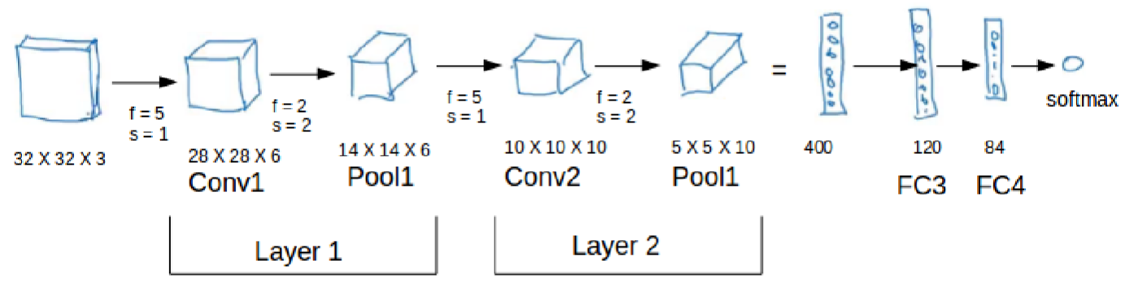
Neural network example
As seen in the above example, the height and width of the input shrinks as we go deeper into the network (from 32 X 32 to 5 X 5) and the number of channels increases (from 3 to 10).

Slide 44
Neural network example
 | Activation shape | Activation Size | # parameters
Input: | (32,32,3) | 3,072 | 0
CONV1 (f=5, s=1) | (28,28,8) | 6,272 | 208
POOL1 | (14,14,8) | 1,568 | 0
CONV2 (f=5, s=1) | (10,10,16) | 1,600 | 416
POOL2 | (5,5,16) | 400 | 0
FC3 | (120,1) | 120 | 48,001
FC4 | (84,1) | 84 | 10,081
Softmax | (10,1) | 10 | 841
Understanding and Calculating the number of Parameters in Convolution Neural Networks (CNNs)

Slide 45
Convolutional Neural Networks
Why convolutions?

Slide 46
Why convolutions
10 | 10 | 10 | 0 | 0 | 0
10 | 10 | 10 | 0 | 0 | 0
10 | 10 | 10 | 0 | 0 | 0
10 | 10 | 10 | 0 | 0 | 0
10 | 10 | 10 | 0 | 0 | 0
10 | 10 | 10 | 0 | 0 | 0
0 | 30 | 30 | 0
0 | 30 | 30 | 0
0 | 30 | 30 | 0
0 | 30 | 30 | 0
1 | 0 | -1
1 | 0 | -1
1 | 0 | -1
Parameter sharing: A feature detector (such as a vertical edge detector) that’s useful in one part of the image is probably useful in another part of the image.
Sparsity of connections: In each layer, each output value depends only on a small number of inputs.

Slide 47
Why convolutions
Consider the following example:
If we would have used just the fully connected layer, the number of parameters would be = 32*32*3*28*28*6, which is nearly equal to 14 million! Makes no sense, right?
If we see the number of parameters in case of a convolutional layer, it will be = (5*5 + 1) * 6 (if there are 6 filters), which is equal to 156. Convolutional layers reduce the number of parameters and speed up the training of the model significantly.

Slide 48
Summary
There are primarily two major advantages of using convolutional layers over using just fully connected layers:
Parameter sharing
In convolutions, we share the parameters while convolving through the input. The intuition behind this is that a feature detector, which is helpful in one part of the image, is probably also useful in another part of the image. So a single filter is convolved over the entire input and hence the parameters are shared.
2. Sparsity of connections:
The second advantage of convolution is the sparsity of connections. For each layer, each output value depends on a small number of inputs, instead of taking into account all the inputs.

